Slide 1

Driver Drowsiness Detection using Neural Transfromers
20BCS073 Aadil Mohammad Hussain
20BCS019 Ebadul Islam Farooqi
Under the Supervision of
DR. Sarfaraz Masood

Slide 2
Overview
Abstract
Introduction
Literature Review
How will we implement it
Vision Transfromers
Why ViT over CNN
Integrating model into our DDD system
Datasets used
References

Slide 3
Abstract
The Driver Drowsiness Detection (DDD) project aims to improve road safety by addressing the dangers associated with drowsy driving. Utilizing advanced sensors and machine learning algorithms, the system monitors realtime physiological and behavioral indicators of the driver. Key components include a facial recognition camera, eyetracking infrared sensors, and a heart rate monitor. The DDDS employs a multi-stage approach, analyzing facial expressions and eye movement for early signs of drowsiness. Upon detecting drowsiness, the system activates timely alerts, such as visual and auditory warnings, or haptic feedback to prompt the driver to take corrective action. The DDDS contributes to the development of intelligent transportation systems, prioritizing road user safety through proactive measures against drowsy driving.

Slide 4
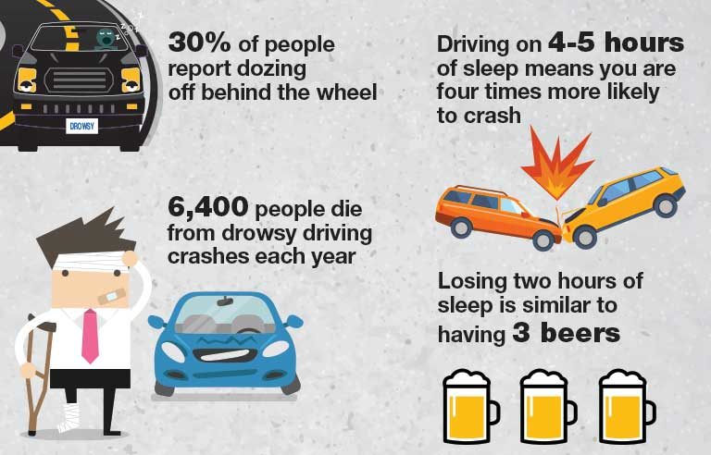
Introduction
Drowsy driving poses a significant risk on the roads, especially in India where adult sleeping problems are prevalent.
According to the National Highway Traffic Safety Administration (NHTSA), in 2017 drowsy driving led to at least 91,000 crashes, resulting in roughly 50,000 injuries and 800 deaths.
Non Tech Solutions include prioritizing sufficient sleep, recognizing warning signs of drowsiness, taking breaks during long drives, avoiding alcohol and medications that induce drowsiness, and planning journeys to minimize driving during late hours

Slide 5
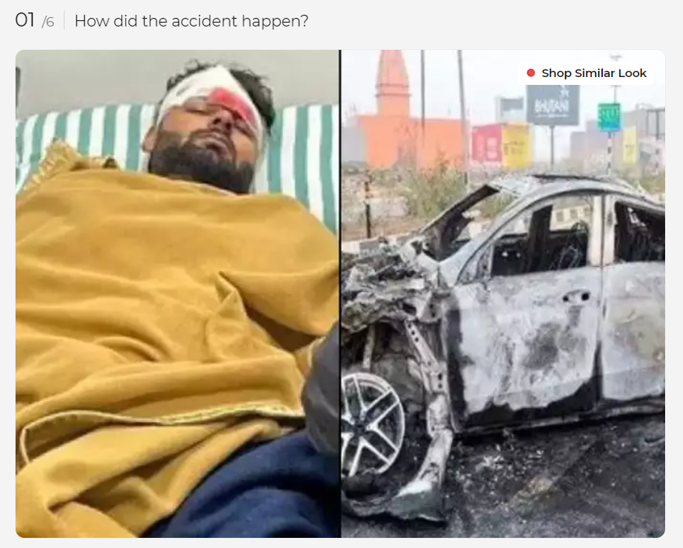
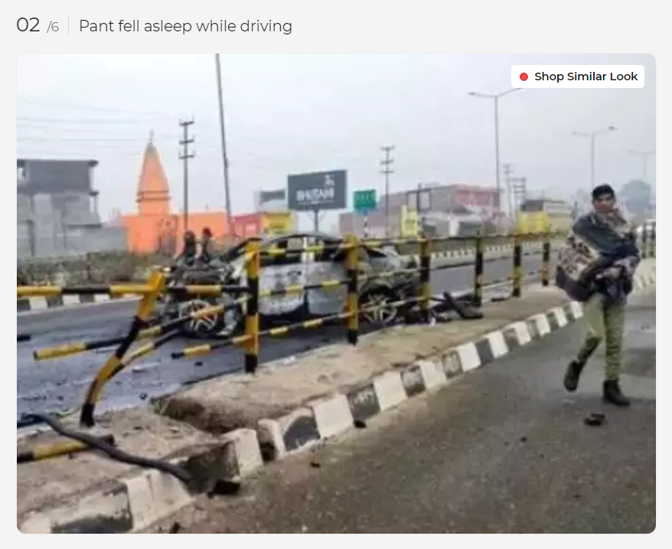
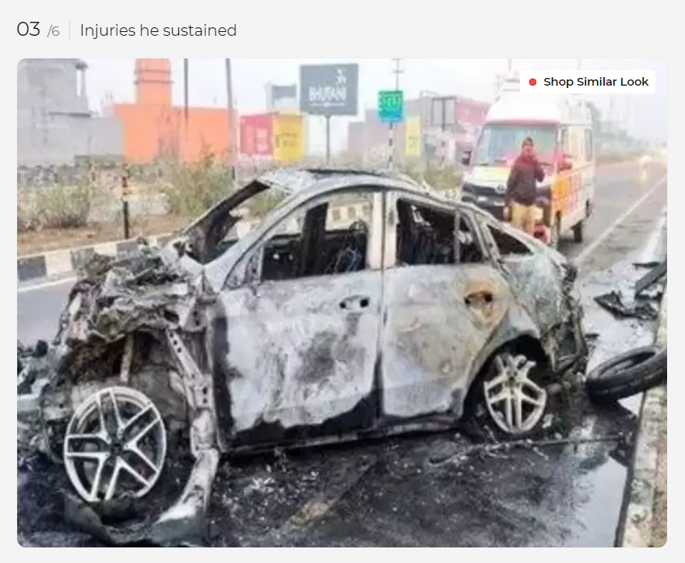
https://timesofindia.indiatimes.com/life-style/health-fitness/health-news/rishabh-pant-met-with-an-accident-fell-asleep-while-driving-note-these-crucial-donts-to-avoid-car-accidents/photostory/96620080.cms?picid=96620633

Slide 6
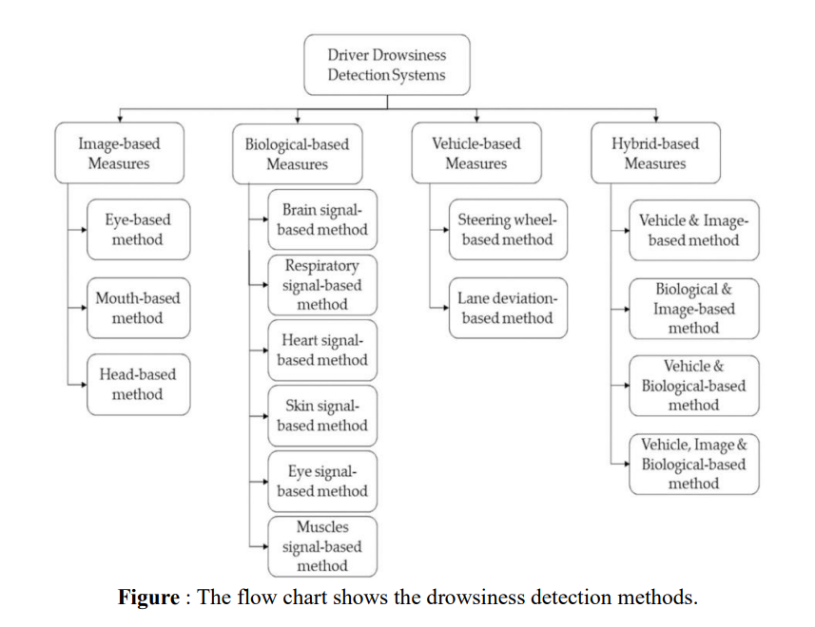
DDD system has been mainly implemented by researchers in four different ways :

Slide 7
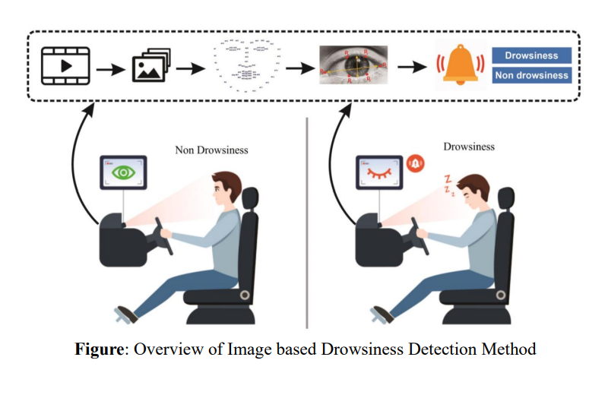
Introduction (…continued)
1. Image-based drowsiness detection involves face, eye, mouth and head detection using a camera placed in the car. Movements of these features are monitored to assess the driver's readiness to drive, with a warning message issued if signs of drowsiness are detected.

Slide 8
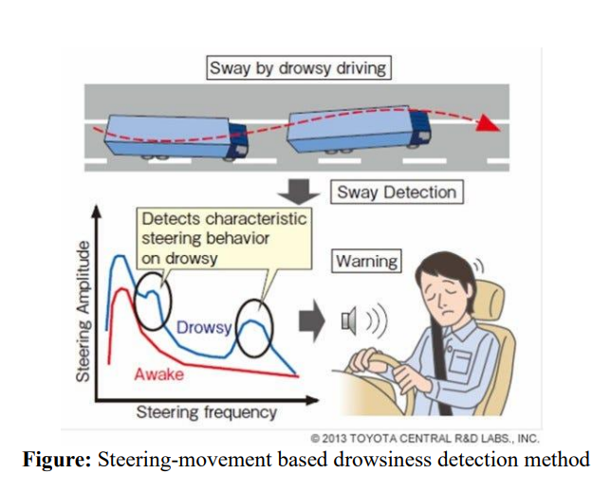
Introduction (…continued)
2. Biological-Based Measures: Recording bio-signals, like EEG signals indicating brain activity, via sensors on the driver's body provides accurate drowsiness detection.
3. Vehicle-Based Measures: Analyzing driving patterns, such as steering wheel angle and lane departure data, distinguishes drowsy from alert drivers.
4. Hybrid-Based Measures: Combining image-, biological-, and vehicle-based measures enhances the accuracy of drowsiness detection systems.

Slide 9
Literature Review
Title | Journal | Year | Description
Real-time Driver Drowsiness Detection for Android Application Using Deep Neural Networks Techniques | Computer Science Procedia | 2018 | The paper proposes a novel approach to dealing with real-time drowsiness detection based on deep learning methods that can be implemented on Android applications with high accuracy. Minimal network structure is designed based on facial landmark key point detection. The proposed model accuracy is 80%.
Real-Time Driver-Drowsiness Detection System Using Facial Features | IEEE Explore | 2019 | The paper proposes a system called DiCare, which measures fatigue status by yawning, blinking and duration of eye closure. They propose a face tracking algorithm to improve the tracking accuracy. The experimental results showed that DriCare had accuracy around 92%.
Driver Drowsiness Detection Using Deep Learning | Springer Link | 2021 | The author puts forward a deep-learning based approach to detect the drowsiness of the driver. They achieve an accuracy of average 96%.
Real-time monitoring of driver drowsiness on mobile platforms using 3D neural networks | Springer Link | 2020 | The author uses depthwise separable 3D convolutions, combined with an early fusion of spatial and temporal information, to achieve a balance between high accuracy and real-time inference requirements.
MobileViT: Light-weight, General-purpose, and Mobile-friendly Vision Transformer | ICLR | 2021 | The author introduce a light-weight general purpose transformer MobileViT, which are perfect for Mobile Tasks as they are able to learn inductive biases and are able to wok on low latency like other transformers.

Slide 10
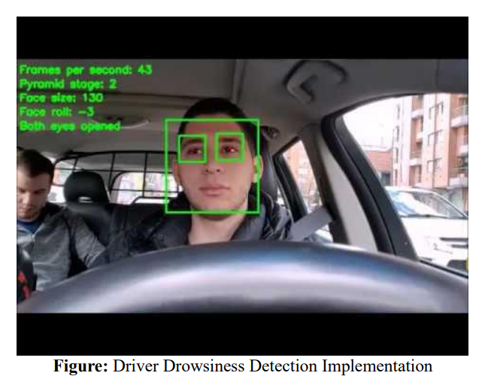
How will we implement it?
We will implement ours using Image-Based Drowsiness Detection System.
Image-processing techniques are applied to detect the eye status as well as head movement to determine eye movement, yawning, nodding, etc.
By constantly monitoring the eyes and head of the driver we will be able to detect driver fatigue in real time and able to alert the driver when needed.

Slide 11
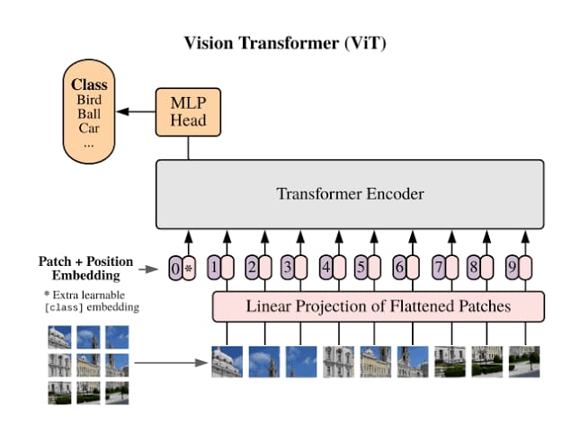
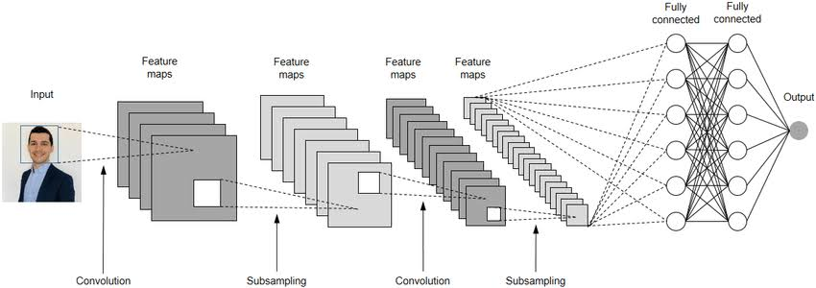
Using Vision Transformers!!!!
A new technology has emerged in the field of Computer Vision as the competitive alternative to Convolutional Neural Network (CNN’s) which is widely used in Computer Vision Field, known as Vision Transformers (ViT).
Popular ChatGPT AI bot is itself based on Transformers Based Model.
Transformers-based architecture is the highest standard for tasks involving Natural Language Processing (NLP), However its use case pertaining to Computer Vision remains only few.
But with recent developments, Vision Transformers have achieved highly competitive performance setting a benchmark in tasks like Object Detection, Image Classification and Semantic Image segmentation.

Slide 12


How Does Vision Transformer Function?
ViT uses a certain special mechanism known as “attention”. In attention we find the inter-relation between the inputs and the information associated with the input in a parallelized manner. For example in NLP if we want to translate one sentence to another, attention would allow us to measure how each word in the input sentence is associated with each word in the ouput sentence. Similar process is applied to image in vision transformers. Similarly there is a concept known as “self-attention” in which we measure the effect of a specific word on all other words in a given sequence or input. It is also known as intra-sequence attention or intra-attention.

Slide 13
Steps involved in Vision Transformers (ViT)-
Split Images into Patches. (fixed sizes)
Flatten the image patches.
Create Lower Dimensions linear embeddings from the flattened image patches.
Include Positional Embeddings.
Feed the sequence as an input to start-of-the-art transformer encoder.
Pre-train the ViT model with image labels, which is then fully supervised on big dataset.
Fine-tune the downstream dataset for image classification.

Slide 14


Slide 15
Why use ViT instead of CNN?
ViT models have been shown outperform CNNs by almost four-times when it comes to computational efficiency as they require four times less computer resources when trained on sufficient data .
ViT scale better with models and dataset size than CNN. ViT give better accuracy and results than CNNs with larger dataset size.
ViT rely on self-attention mechanism, enabling them to capture long range dependencies and global context within images, a feature not found in CNNs.
CNNs tend to have inductive biases. Inductive bias or learning bias is the assumption the model makes when making presumptions. Vision Transformers do not have these biases making them work well generalized by the approach of their method.

Slide 16
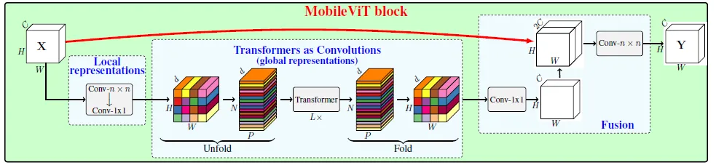
MobileViT
The specific model that we will be using for our project is MobileViT, which is a light-weight general purpose model ViT specifically build for mobile devices.
Mobile ViT uses both transformers and convolutions in a way that the resultant MobileViT block has convolutional-like properties while simultaneously allowing for global processing. This modelling capability allows us to design shallow and narrow MobileViT models.

Slide 17
Mobile ViT vs Mobile Net
Mobile ViT and Mobile Net are both architectures designed for mobile devices, but they approach image classification in different ways.
Mobile ViT combines the strengths of convolutional neural networks (CNNs) and vision transformers (ViTs) to create a lightweight and efficient model for mobile vision tasks
MobileNet, on the other hand, is a CNN-based architecture that uses depthwise separable convolutions and a width multiplier to reduce the number of parameters and computational cost.
In terms of performance, MobileViT outperforms MobileNet, for a similar number of parameters. MobileViT is 5.7% more accurate than MobileNet for a similar number of parameters on the object detection tasks. MobileViT also provide you with better mAP(mean average precision) .
Mobile ViT offers better performance than MobileNet and DeiT for image classification tasks, while maintaining efficiency on mobile devices. However, MobileNet remains a popular choice for its simplicity and efficiency on mobile device as it requires less inference time because of simpler architecture.

Slide 18
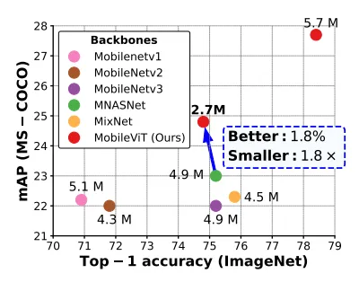
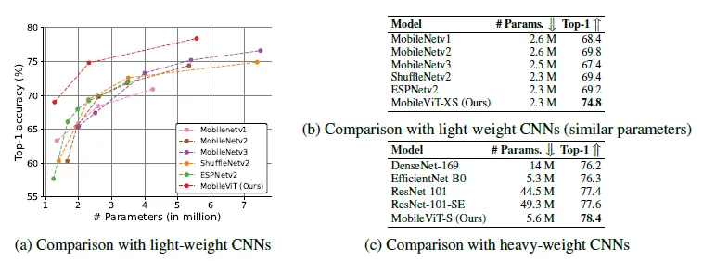
Mobile ViT gives better accuracy and mAP as compared to other models.
We see that with similar number of parameters MobileViT performs better than both Heavy Weight and Light Weight CNNs.
Taken from : “MobileViT: Light-weight, General-purpose, and Mobile-friendly Vision Transformer”

Slide 19
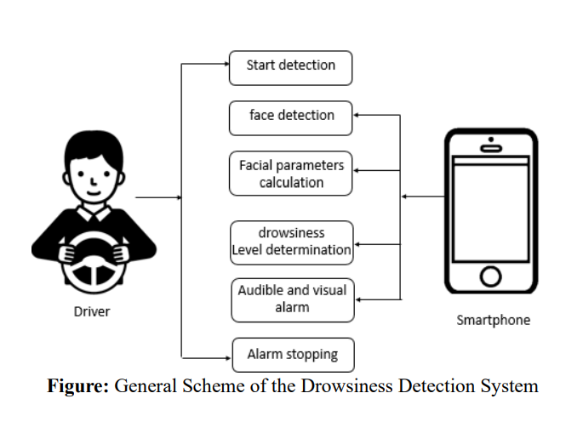
Integrating the model into our DDD System
After implementing the model, we intend to integrate it with our cellular system so that the user of Drowsiness Detection System can use it from anywhere at anytime with ease.

Slide 20
Database used in DDD Systems
Dataset Name | Size | Format | Items | Classes
National Tsing Hua University DDD Dataset | 5 GB | RGB Videos | 36 video footage of total 9 and a half hour | Drowsy and Non-Drowsy
University of Texas of Arlington Real-Life Drowsiness Dataset | 111.2 GB | RGB Videos | 30 hour of video footage | Alert, Low Vigilante and Drowsy
Kaggle-Driver Drowsiness Dataset | 3 GB | RGB Images | 41,790 images | Drowsy and Non-Drowsy
Driver Drowsiness Dataset | 169 MB | RGB Images | 2900 images | Eyes Open, Closed, Yawning and No yawning

Slide 21
References
Albadawi, Y., Takruri, M., & Awad, M. (2022). A Review of Recent Developments in Driver Drowsiness Detection Systems. Sensors (Basel, Switzerland), 22(5), 2069. https://doi.org/10.3390/s22052069
R. K. M, R. V and R. G. Franklin, "Alert System for Driver’s Drowsiness Using Image Processing," 2019 International Conference on Vision Towards Emerging Trends in Communication and Networking (ViTECoN), Vellore, India, 2019, pp. 1-5, doi: 10.1109/ViTECoN.2019.8899627.
Poursadeghiyan, M., Mazloumi, A., Nasl Saraji, G., Baneshi, M. M., Khammar, A., & Ebrahimi, M. H. (2018). Using Image Processing in the Proposed Drowsiness Detection System Design. Iranian journal of public health, 47(9), 1371–1378.
Dosovitskiy, A., Beyer, L., Kolesnikov, A., Weissenborn, D., Zhai, X., Unterthiner, T., Dehghani, M., Minderer, M., Heigold, G., Gelly, S., Uszkoreit, J., & Houlsby, N. (2020). An Image is Worth 16x16 Words: Transformers for Image Recognition at Scale. ArXiv, abs/2010.11929.

